Slide 1

Project 1 presentation
GLADIATOR EDITION

Slide 2

EXECUTIVE SUMMARY
Our project answers the big questions of life - gladiator survival. How did they survive, what helped them in the arena and who survived most often with these factors. We have answered these questions on your behalf. We will show how the data was sourced, prepped, and the results, along with some graphs for your visual pleasure and aid. Are you ready to be entertained?

Slide 3

OUR APPROACH
Initially we were interested in ACL tears in professional and college athletes, but when going through datasets we discovered one named Gladiator Combat Records and Profiles Dataset and were hooked. We then started asking questions about what could be answered by this dataset, and the most interesting topic to all of us was survival rates and what factors could influence survival in the arena. People took the question that most interested them and started coding or working on the ReadMe.

Slide 4

OVERVIEW OF DATA PROCESSING
Data Collection
Data was sourced from an online database in Kaggle. We used pandas to read the data from our csv file and create dataframes for analysis.
Data Cleaning
We all encountered issues of missing or non-existent data; data was filtered and processed to resolve this problem
Data Analyzation and Visualization
We used matplotlib to visualize with distinct charts. This helped create data which were easy to interpret and analyze.

Slide 5

OUR RESULTS
Our long-anticipated results await you. Are you ready? Let's go!

Slide 6
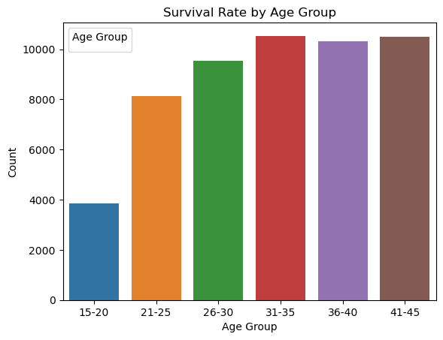
ARE YOUNGER GLADIATORS MORE LIKELY TO WIN OR SURVIVE THAN OLDER ONES?

Slide 7
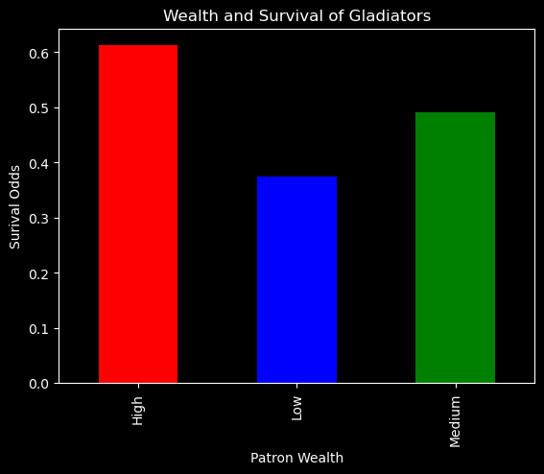
HOW DO GLADIATORS WITH DIFFERENT LEVELS OF PATRON WEALTH COMPARE IN TERMS OF EQUIPMENT QUALITY AND SURVIVAL RATES?

Slide 8
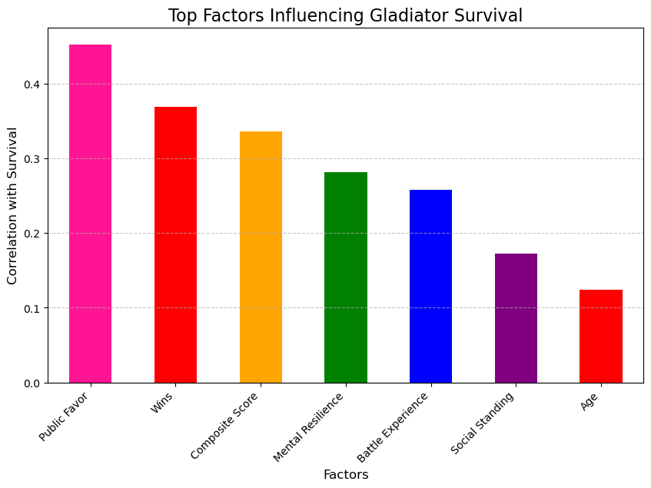
WHAT FACTORS MOST INFLUENCE WHETHER A GLADIATOR SURVIVES?
2 questions need to be answered:
What is public favor?
what factors go into the composite score?

Slide 9
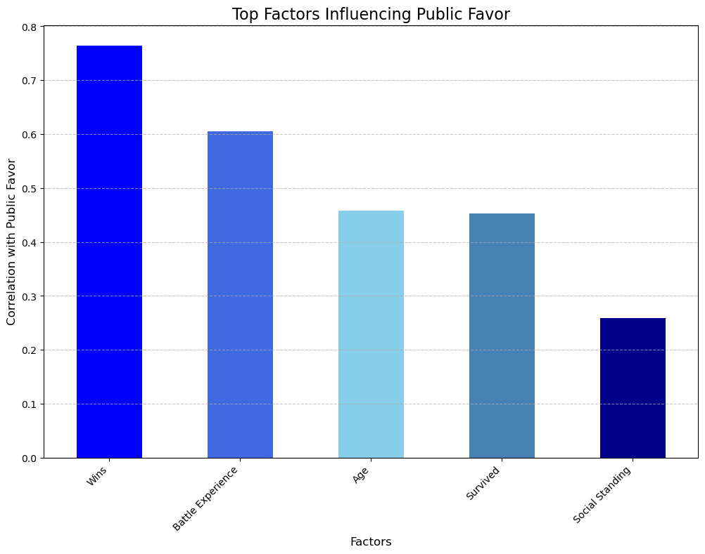
what are the factors that go into public favor?

Slide 10
Explanation of Weights for composite score:
Wins: are weighted most heavily as they reflect direct success in battles.
Battle Experience: is the second most important factor, as seasoned gladiators are likely to perform better.
Public Favor: Popularity among the crowd matters but is given slightly less weight.
Survived: Survival status contributes a small amount to the score.

Slide 11
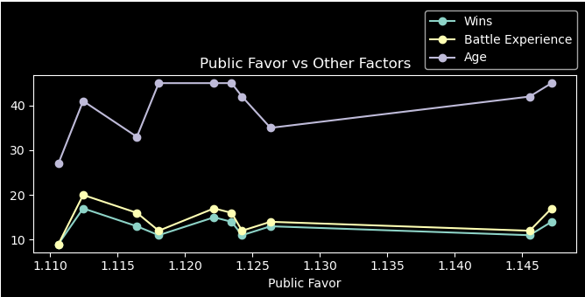
CAN PUBLIC FAVOR BE PREDICTED FROM ATTRIBUTES SUCH AS CROWD APPEAL TECHNIQUES AND SOCIAL STANDING?

Slide 12
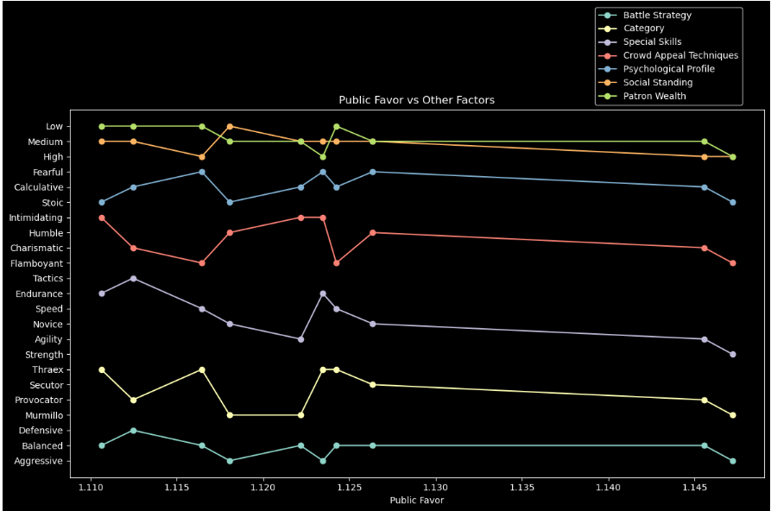

Slide 13
conclusion
what is the biggest factor for survival?
Public Favor!

Slide 14
Bonus question: who were the top ten gladiators?

Slide 15
